Slide 1
PROJECT REPORT on E-retail factors for customer activation and retention: A case study from Indian e-commerce customers By Sreekari I

Slide 2
INTRODUCTION
Customer satisfaction has emerged as one of the most important factors that guarantee the success of online store; it has been posited as a key stimulant of purchase, repurchase intentions and customer loyalty.
A comprehensive review of the literature, theories and models have been carried out to propose the models for customer activation and customer retention.
Five major factors that contributed to the success of an e-commerce store have been identified as: service quality,
system quality,
information quality,
trust and
net benefit.
The research furthermore investigated the factors that influence the online customers repeat purchase intention. The combination of both utilitarian value and hedonistic values are needed to affect the repeat purchase intention (loyalty) positively.

Slide 3
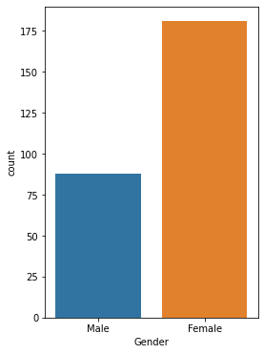
This bargraph shows the gender distribution.

Slide 4
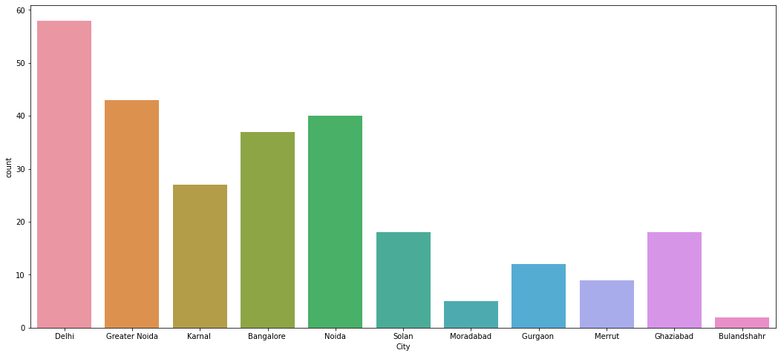
The below bargraph shows the number of customers from the various cities. We can see that the customers in the dataset belongs to Delhi, Greater Noida, Kamal, Bangalore, Noida, Solan City, Moinabad, Gurgoan, Merut, Ghaziabad, Bulandshahr.

Slide 5
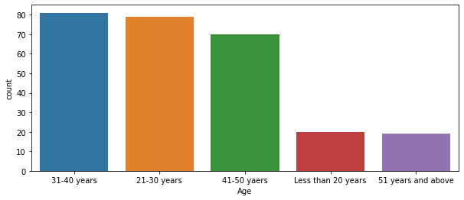
We can see that the customers are highest and almost equal in the Age groups 31-40 years and 21-30 years. It is followed by 41-50 years, less than 20 years and 51 years and above Age groups.

Slide 6
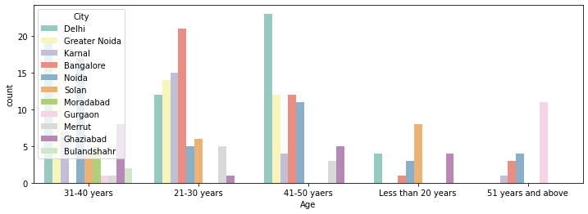
We can see that a large number of surveyed people between the Age group 31-40 years and 41-50 years from Delhi has highest number of e-Commerce sites users in the Age group 21-30 years. Solan has the highest number of users in the Age Group Less than 20 years. In the Age group 51 years and above, Gurgaon has highest ce sites. Bangalore has the number of users when compared to the other cities in the dataset.

Slide 7
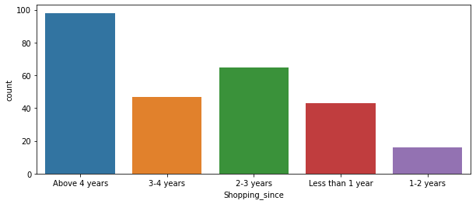
The customers who are shopping since 4 years and above are highest followed by 2-3 years, 3-4 years while customers shopping since 1-2 years being the least.

Slide 8
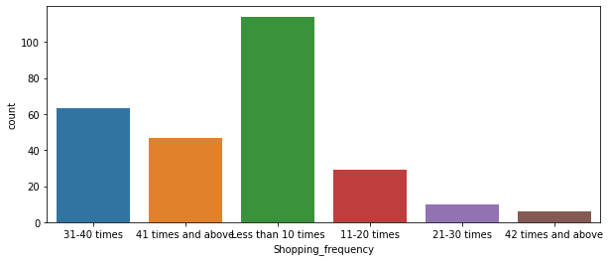
There are more customers who shopped less than 10 times followed by 31-40 times, 41 times and above while the customers who shopped 42 times and above being the least.

Slide 9
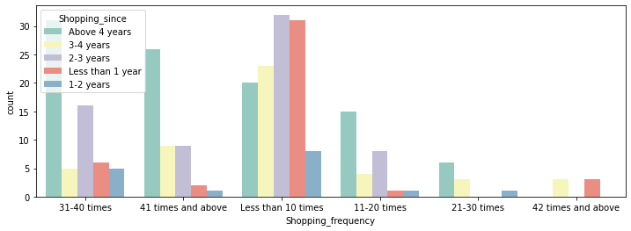
On comparing the shopping frequency with the shopping since, we can see that the customers who are shopping from above 4 years have shopping frequency of 41 times and above. It shows that the customers who are shopping from a long time are using the shopping sites frequently.

Slide 10
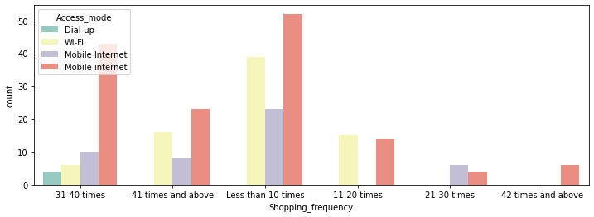
Comparing shopping frequency with the access mode for online shopping used.

Slide 11
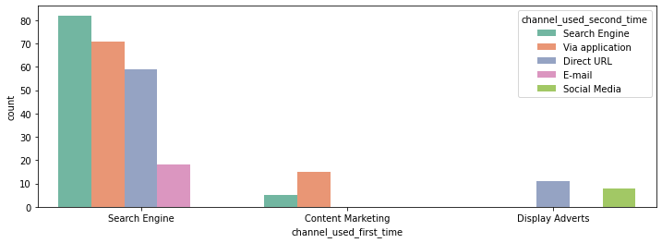
Comparing the channel used for shopping for the first time and the channel used for the second time

Slide 12
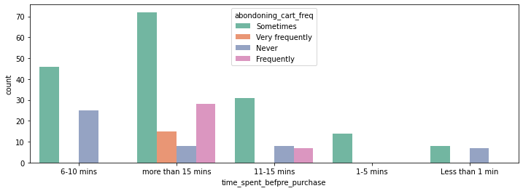
We can see how the time spent before purchase is related to abandoning the cart frequency.

Slide 13
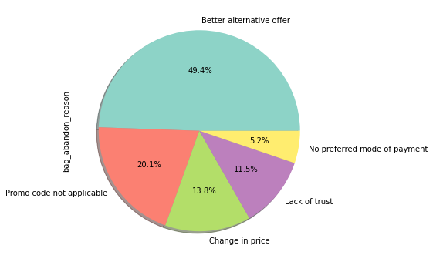
We can see that 49.4% of the bag abandon reason is due to the better alternative offer. It is followed by Promo code not available, Change in Price, lack of trust and No preferred mode of payment.

Slide 14
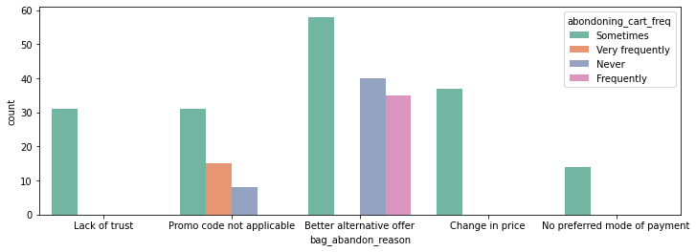

Slide 15
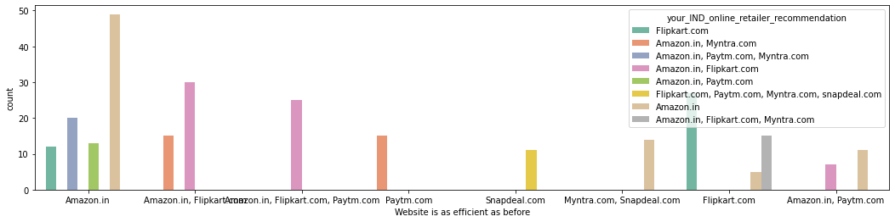
The comparison between the reason for abandoning the cart and frequency of abandoning the cart shows that better alternative reason available is the frequent reason while the Promo code not available is never in some of the cases and it is sometimes in case of better alternative available. Lack of trust is also the reason in some cases and No preferred mode of payment is the reason in few cases.

Slide 16
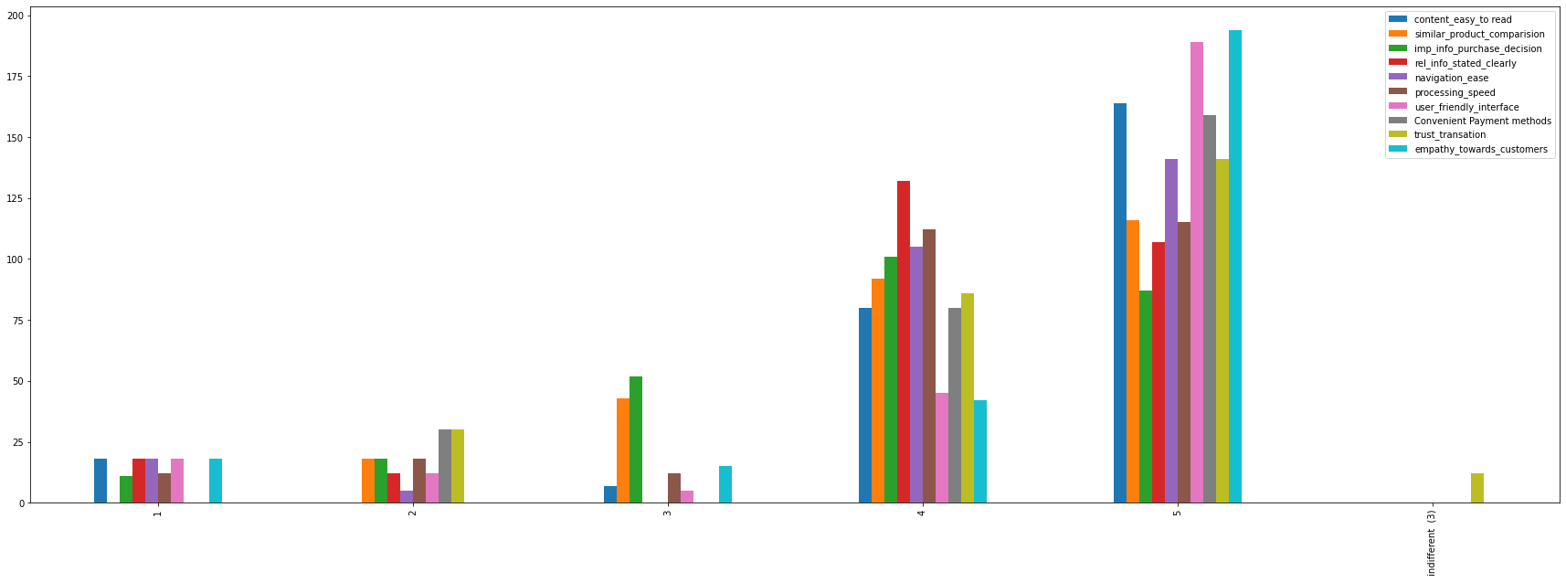
The following three bargraphs shows the opinions frequency on various columns.

Slide 17
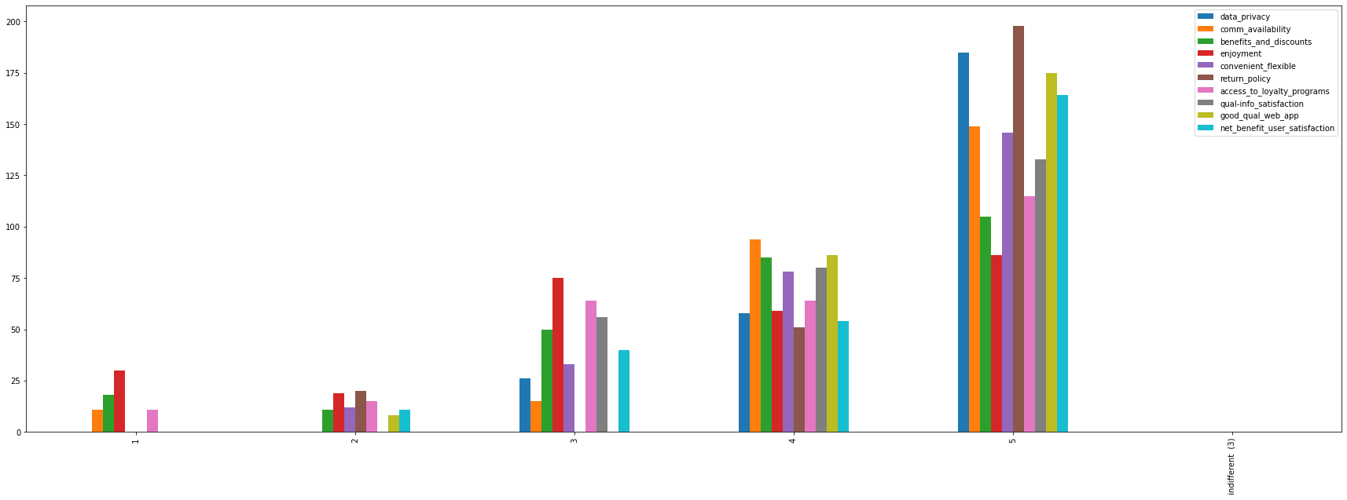

Slide 18
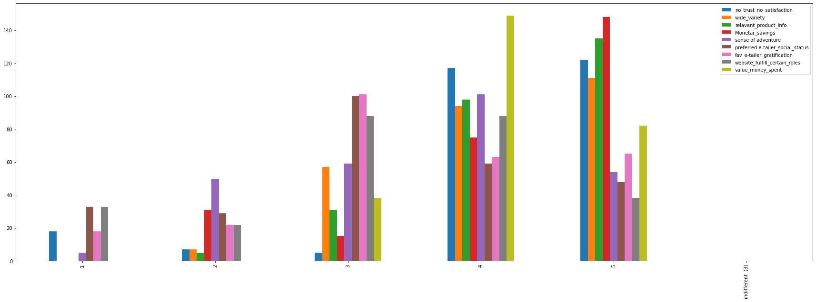

Slide 19
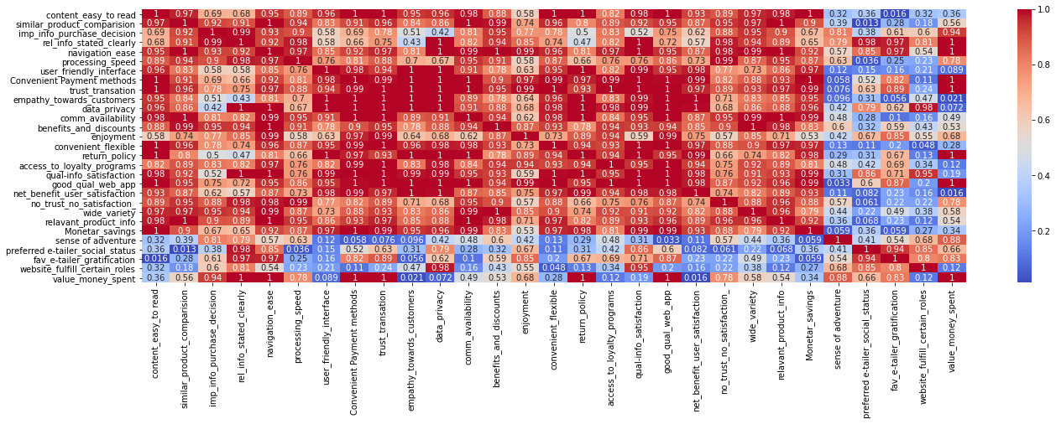
Correlation between the columns about customers opinions on online shopping
We can see that good quality of the website gives enjoyment to the customers as they have positive correlation of 0.99. Also, content easy to read and relavant product info also has high positive correlation. There are certain other factors which affect the shopping experience.

Slide 20
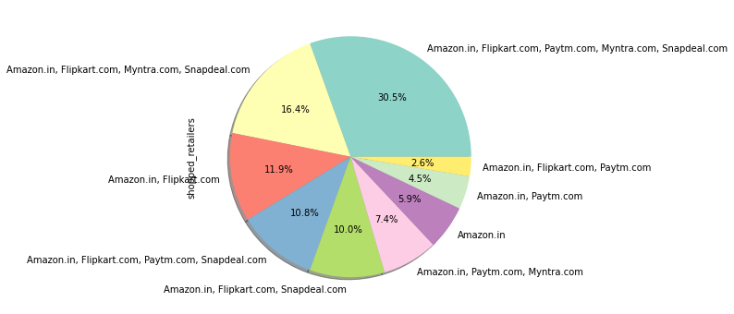
We can see the different online sites from which customers have shopped and the percentages from this pie-chart.

Slide 21
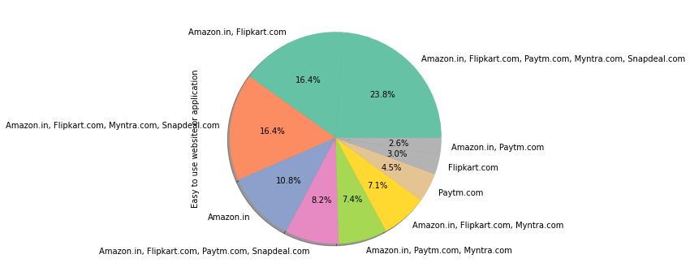
We can see which website/ App that was easy to use based on customer selected options from this pie-chart.

Slide 22
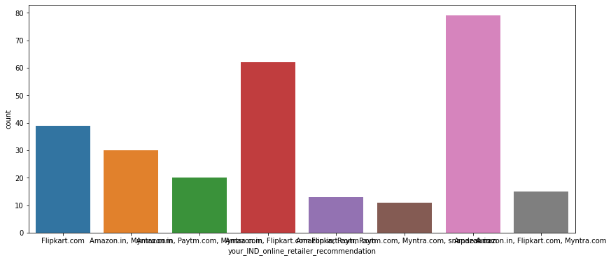
Upon checking the count of various websites recommended by the customers, we can see that the Amazon.in is recommended by many customers followed by Amazon.in, Flipkart.com while Flipkart.com, Paytm.com, Myntra.com, snapdeal.com together being the least.

Slide 23
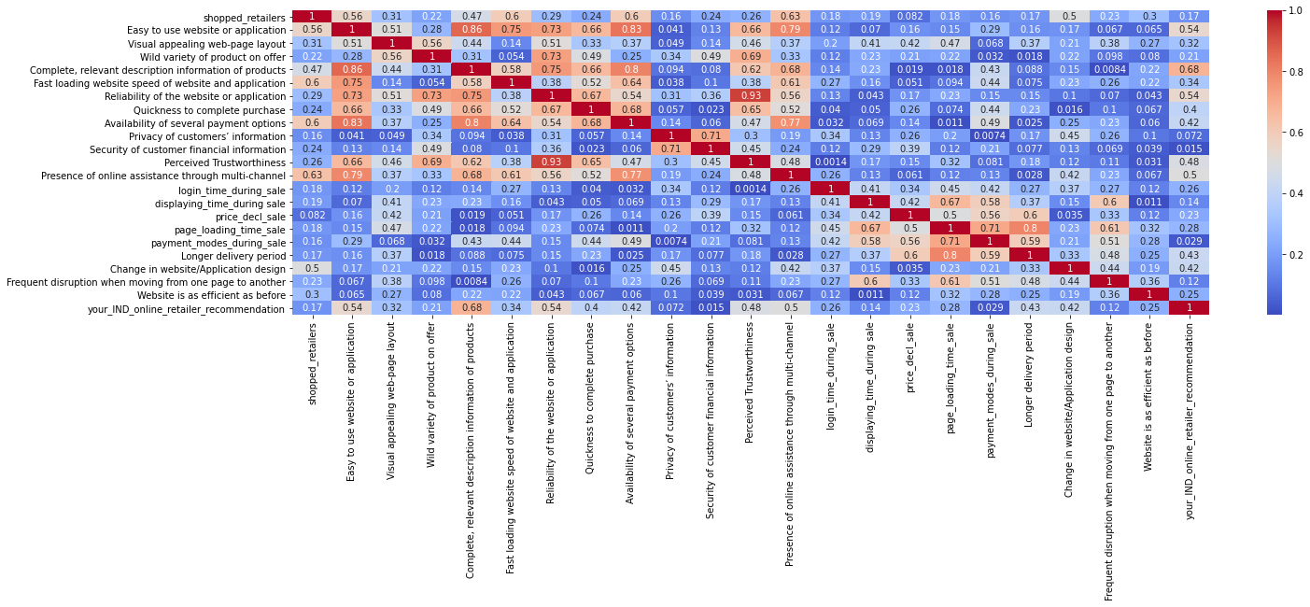
From the below heat map, we can see the correlation between the columns of customers opinions on various e-Commerce websites.
From the above correlation map, we can see that 'Complete, relevant description information of products', 'Easy to use website or application', 'Reliability of the website or application', 'Perceived Trustworthiness', 'Website is as efficient as before', 'Visual appealing web-page layout', 'Wild variety of product on offer' affect the 'your_IND_online_retailer_recommendation'.

Slide 24
CONCLUSION
From the above analysis we can see that online stores should focus on the factors that are necessary for customer satisfaction. All the customers might not have same preference on the same factor however relavant information, Reliability of the website, efficiency of the website, service qualities like communication etc, prove to be the important factors necessary for online shopping users’ satisfaction. So the e-Commerce industries should focus on these factors and provide user friendly interfaces and efficient services for customer retention.

Slide 25
THANK YOU….!!!

